Slide 1

King County House Pricing
Predictive Analysis
By Supermodels RealState GmbH
Henrike Sahnwaldt, Enrique Hernani Ros & Rand Abu Ajamia
💃🏼
🕺🏻
💃🏻

Slide 2

Our Innovative Solution
Objective:
predictive machine learning model
Our solution:
➽ Predicts price of properties with 90% accuracy ➽ Engineered with unique “hotspot” feature to include distance from any location
➽ Tailored to incorporate new data

Slide 3

Data Set Description
Source | Kaggle
Time Period | May 2014 - May 2015
Location | King County, Washington, USA
Amount of Data | 21,597 Records 20 Features
Data Quality | High
Clean Data | No null values, typos, incorrect data types or duplicate records
Notes:
We are starting a new diving in king County in the states, however for a better understanding of the housing market in the region a data driven analysis of the housing market is needed before starting the business operation.
That is where a machine learning model comes into play to predict the house prices in king county and understand the main drives for price changes
Here you can see the location of king county within the sate of Washington
Our data set is from the years 2014 and 2015
It consists of 21,597 record and 20 features such as price, grade, number of rooms etc
It is high quality clean data that had no null values, typos, incorrect data types or duplicate records therefore no data cleaning was required prior processing

Slide 4
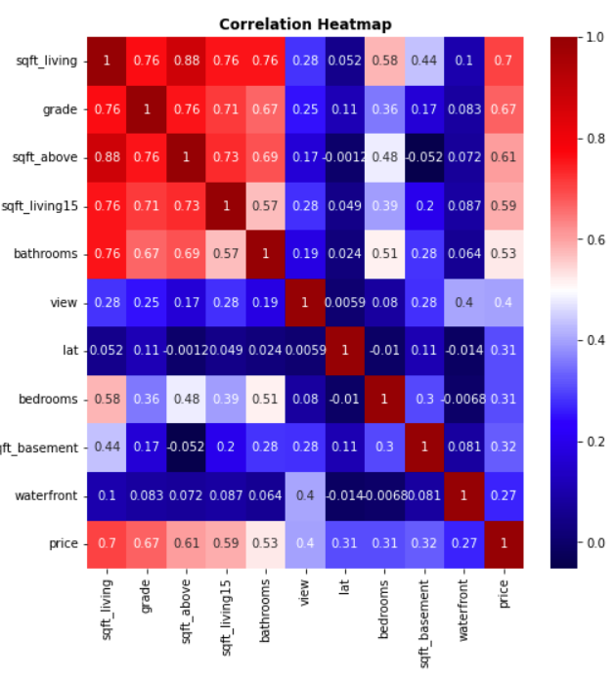
What is driving the price according to the data?
Further explore these estimators
High correlation with living area and building condition
How to treat the location data to improve our model?
Low correlation with the location data
Correlation Heatmap of the 10 most relevant estimators in terms of correlation coefficient
Redundant information. Drop all of them except sqft_living
House area estimators are highly intercorrelated
Notes:
Data Processing for Modelling - the following data transformations were carried out in order to improve the data for modelling purposes
Dropping features highly correlated between them or with very low correlation with the sale price
Treatment of the location data
Normalization of the distribution of important features
Standard Scaling of Numerical Features
Also mention which features were dropped due to low correlation
Reason to drop it
Condition
Building Condition information already contained in Grade
Floor
Yr_renovated (transformed to simpler variable)
sqft_lot
Sqft_lot15
Highly correlated with living
sqft_above
sqft_basement
sqft_living15

Slide 5
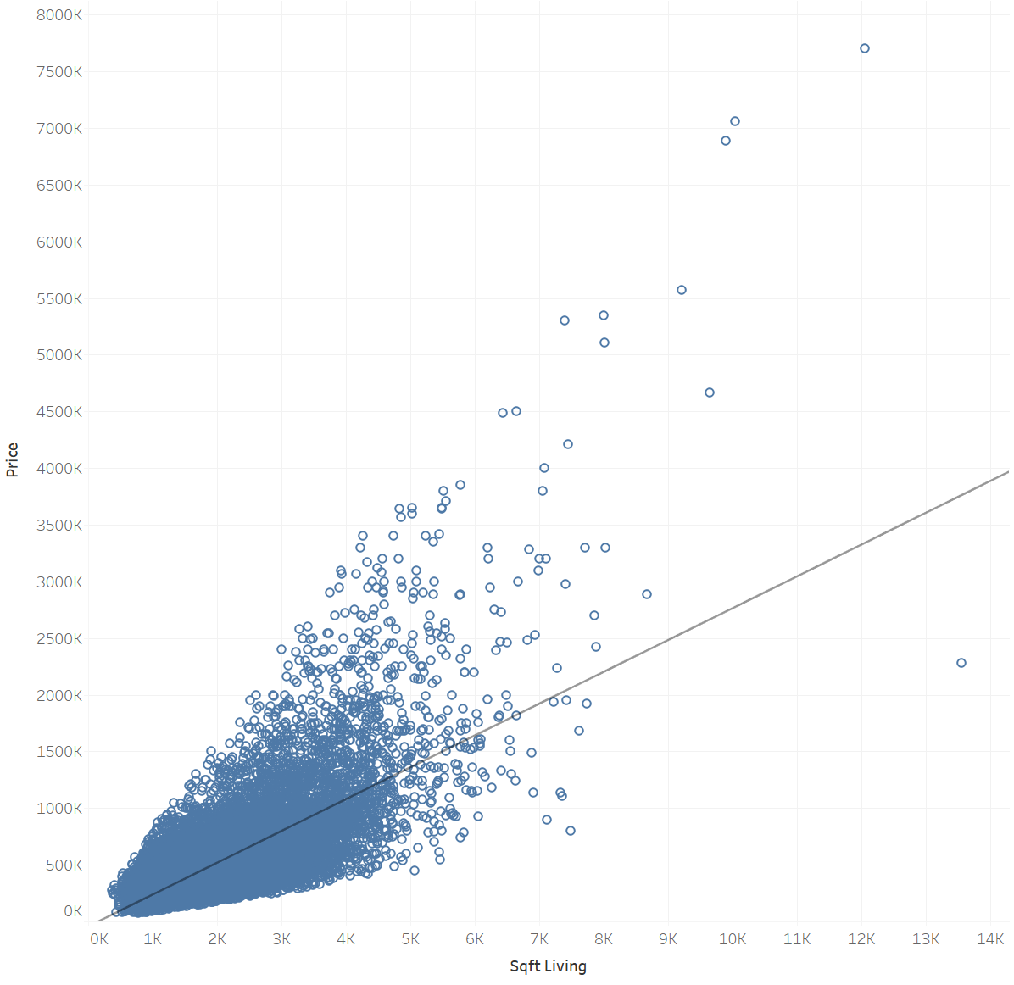
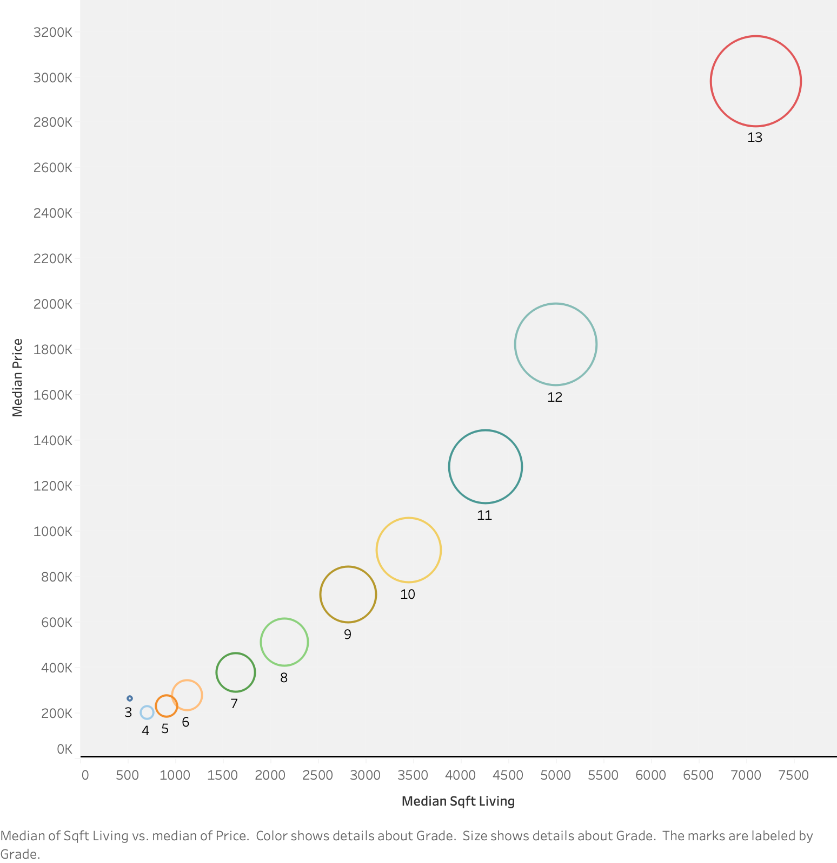
Getting to know our main variables
Price vs living area (sqft)
Grade (1-13) by price & living area (sqft)
Notes:
Living area and building condition have an important effect on the house sale price
Location is usually considered the main driver of the price
Is the house construction year relevant? Or is it actually only important when the house was renovated?
is driving houses sale price?
Correlation price vs sqft living:

Slide 6
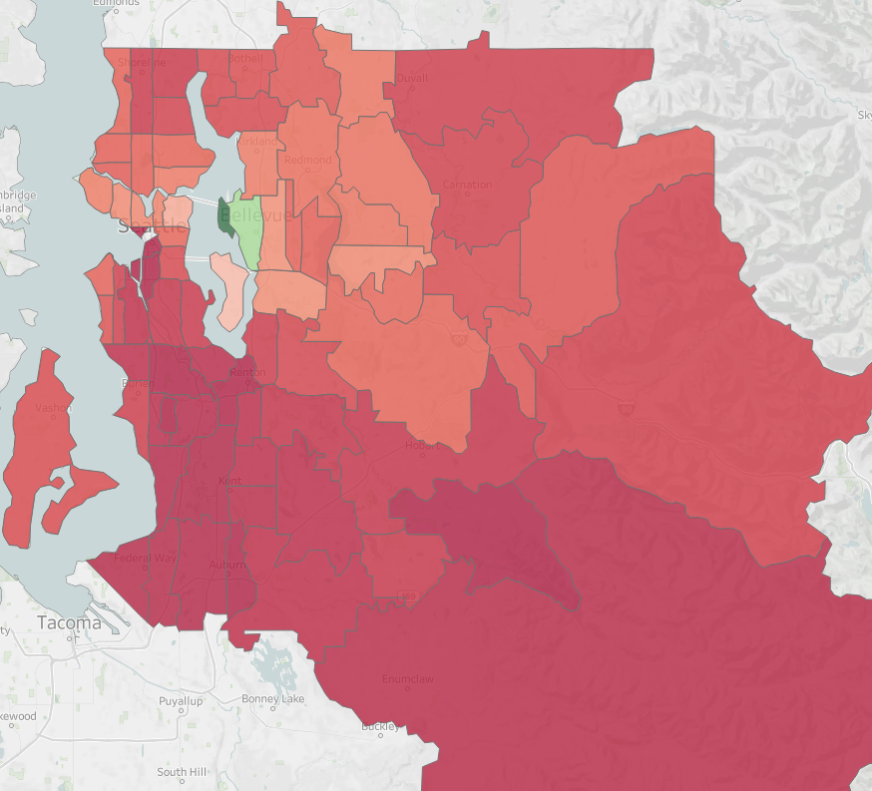
Location Feature Engineering
R2 ▲ +6%
Problem: no correlation between price & ZIP 😢
Solution: engineer a new feature 😍
Compute distance to price “hot spot” Bellevue,
using Haversine formula
Bellevue: 47°36'59.4"N 122°11'20.4"W
Feature | Correlation w. price
ZIP, longitude | ~ 0.05
latitude | 0.31
distance to Bellevue | 0.42
Notes:
Split some of the info into a backup slides (Henrike)

Slide 7
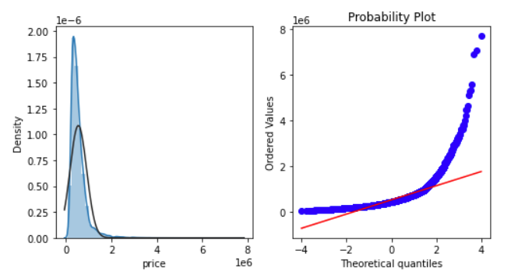
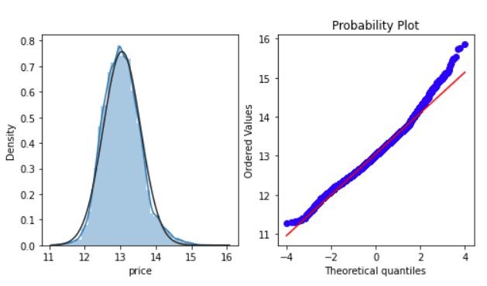
Normalization Transform
R2 ▲ +4%
LN
Original Price Data
Transformed Price Data (Logarithmic)
Notes:
One of the main assumptions behind Linear Regression is that all variables (predictors and target) are normally distributed
This is not the case for the sale price and for our main numerical estimator (living area)
Logarithmic (Price) and Box-Cox (Living Area) transformations have been applied on these variables, leading to an improve in the adjusted R2 coefficient of 4%

Slide 8
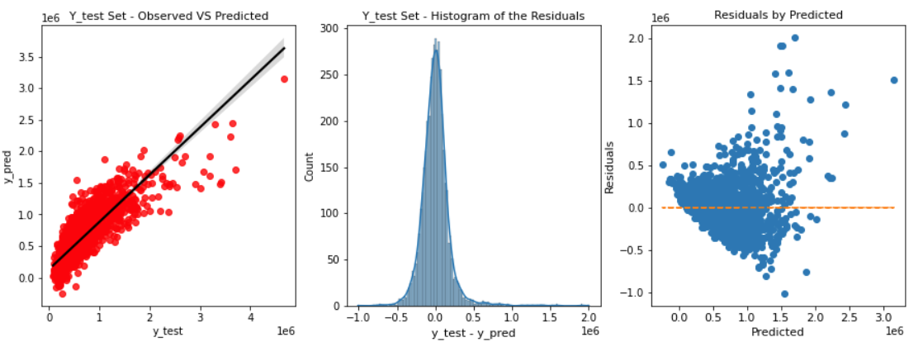
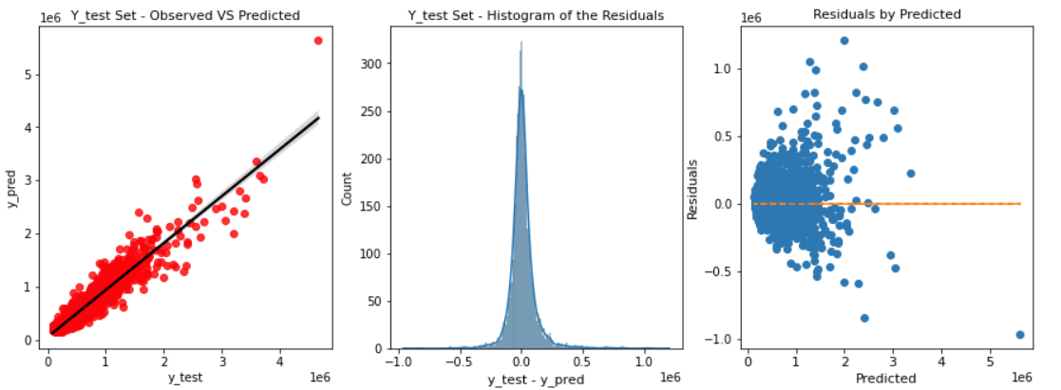
Improving the model
Regression Method | N of Predictors | Transf.? | Train Set |  | Test Set
 |  |  | RMSE ($) | Adjusted R2 | RMSE ($) | Adjusted R2
Linear (Baseline) | 20 | No | 204,389 | 0.70 | 187,189 | 0.71
Linear Transformed | 12 | Yes | 168,308 | 0.79 | 156,397 | 0.81
Ridge Regression (α = 1) | 12 | Yes | 168,316 | 0.79 | 156,348 | 0.81
Polynomial (n=2) | 12 | Yes | 135,866 | 0.87 | 129,882 | 0.86
Extreme Gradient Boosting (Final) | 12 | Yes | 98,718 | 0.93 | 108,025 | 0.90
Baseline Model
Extreme Gradient Boosting

Slide 9
Outro
Achievement
Predictive model with 90% accuracy has been developed
With the right transformations, location data has significant impact on price prediction
Next Steps
Further feature engineering: include distance to next metro station, supermarket, school…
Develop an interactive tool for house price prediction
Should we continue this project, we would now do the following:
Feature engineering:
Location: distance to next metro station, super market, school
Build interactive tool that predicts house prices
Next Step
Next Step
Notes:
Further location improvement
(Henrike)
Houses prices are influenced by additional factors (see Zillow)

Slide 10
Thank you

Slide 12
BackUp Slides
Notes:
Show a the R value graph , changing along the different models
(Kike)

Slide 13
Prepare the data for modelling
Data Cleaning - the quality of the data was very high. No cleaning was required
Data Processing for Modelling - the following data transformations were carried out in order to improve the data for modelling purposes
Dropping features highly correlated between them or with very low correlation with the sale price
Treatment of the location data
Better capture the information regarding building age / renovation year
Outliers treatment
Normalization of the distribution of important features
Standard Scaling of Numerical Features

Slide 14
Features Selection
Features Dropped
Feature | Reason to drop it
Condition | Building Condition information already contained in Grade
Floor | Hypothesis testing shows a p-value >0.05
yr_renovated
sqft_lot
sqft_above
sqft_basement
sqft_living15
sqft_lot15

Slide 15
What about Outliers?
‘bedrooms’ has one outlier value: 33 bedrooms in a house with 2 bathrooms
Conclusion: obviously inconsistent data, delete row
Target variable ‘price’ has large outliers (houses between 2 - 7.7 million $)
But they correspond to outliers in independent features (sqft_living, rooms)
Outliers capture valuable information and variability of our data
Conclusion: Keep outliers to ensure realistic predictions
Notes:
(Henrike)
sqft living, bedrooms & bathrooms, grade, condition, view
We can see that the prices for most houses lie between 75.000 and 1.5 million dollars. There are few extreme values of up to 7.7 million dollars.
Median: 450,000 USD
There was a house which had 33 bedrooms but associated with an unlikely lot size of 6,000 sq. ft and only a single floor. Hence, the record was treated as faulty and removed from the data set.

Slide 16
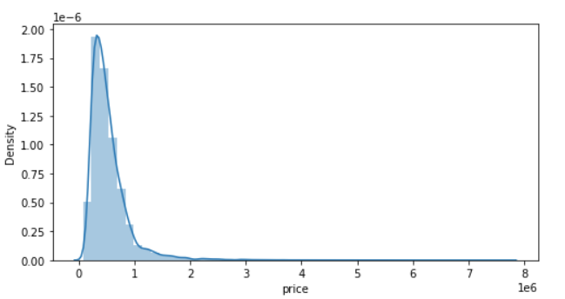
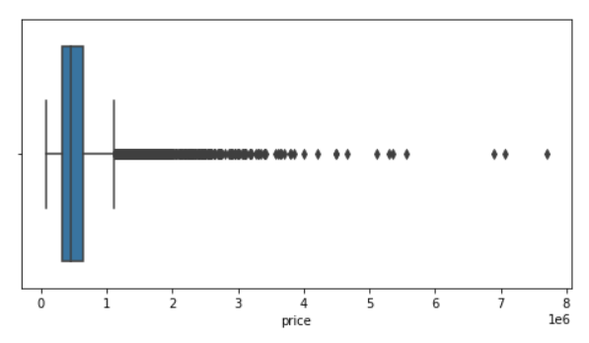
Getting to know our target - Sale Price
Skewness = 4 | Kurtosis = 34
The sale price deviates from a normal distribution with:
Positive Skewness - large right tail
Very High Kurtosis - very high number of extreme values. Are they really outliers?
Standard Deviation | 367K $
Mean | 540K $
Max | 7.7M $

Slide 17
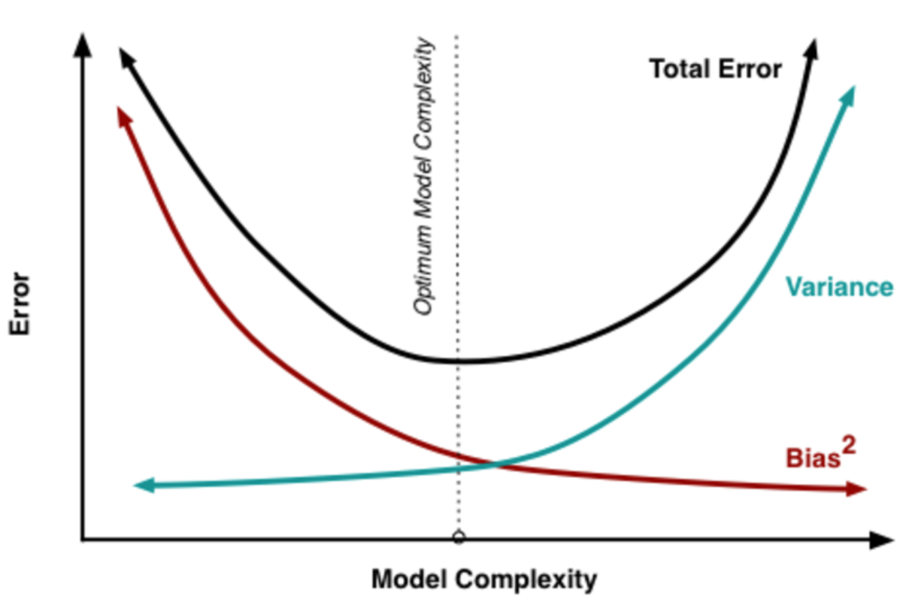
Regularization
(Ridge/Lasso Regression)
R2 ━
In every regression there is a trade-off between bias and variance
Regularization algorithms (for example Ridge and Lasso) purpose is to reduce the magnitude of the fitting coefficients and therefore the complexity of the model and the variance
No improvement in the adjusted R2 coefficient was achieved using Ridge or Lasso Regressions ➔ Our model is not overfitted
Source: researchgate.net

Slide 18
Polynomial Regression
Extreme Gradient Boosting
R2 ▲ +5.8%
R2 ▲ +4.3%
The target is to increase the complexity of the model by increasing the order of the fitting coefficients
Risk of overfitting if the order is increased too much
Machine learning technique for regression and classification problems based on ensembling simpler models, normally decision trees
Implemented in Python with XGBoost library
Initial Linear Model
Model with polynomial features
Linear Regression
Polynomial Regression Model
We transform our original features into “new” features with a higher order
The relationship between our “new” high order features and the target is still linear
Notes:
(Kike)

Slide 19
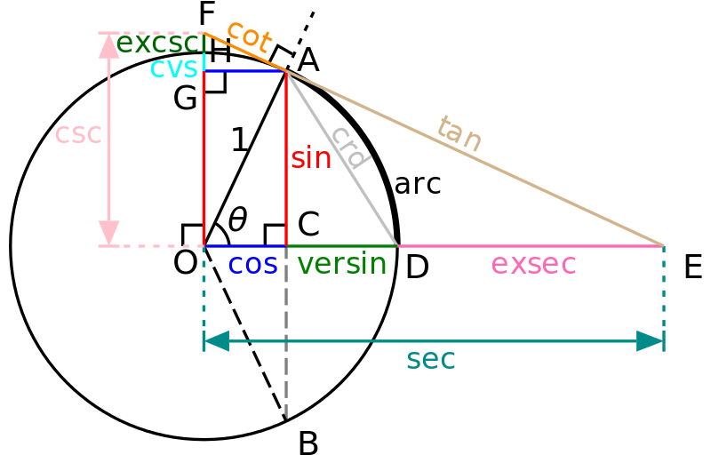
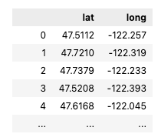
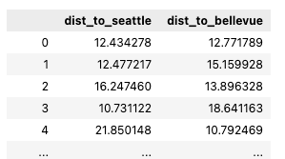
Location Feature Engineering
Bellevue
Problem: no correlation between price & ZIP :(
Solution: engineer a new feature! :)
Compute distance to price “hot spot”
using Haversine formula:
house GPS data -> Bellevue GPS data -> distance in km
47.616492, -122.188985
a = sin²(ΔlatDifference/2) + cos(lat1).cos(lt2).sin²(ΔlonDifference/2)
c = 2.atan2(√a, √(1−a))
d = R.c
0.31 0.02
<- correlation w. price increased ->
0.29 0.42
Notes:
Split some of the info into a backup slides (Henrike)

Slide 20
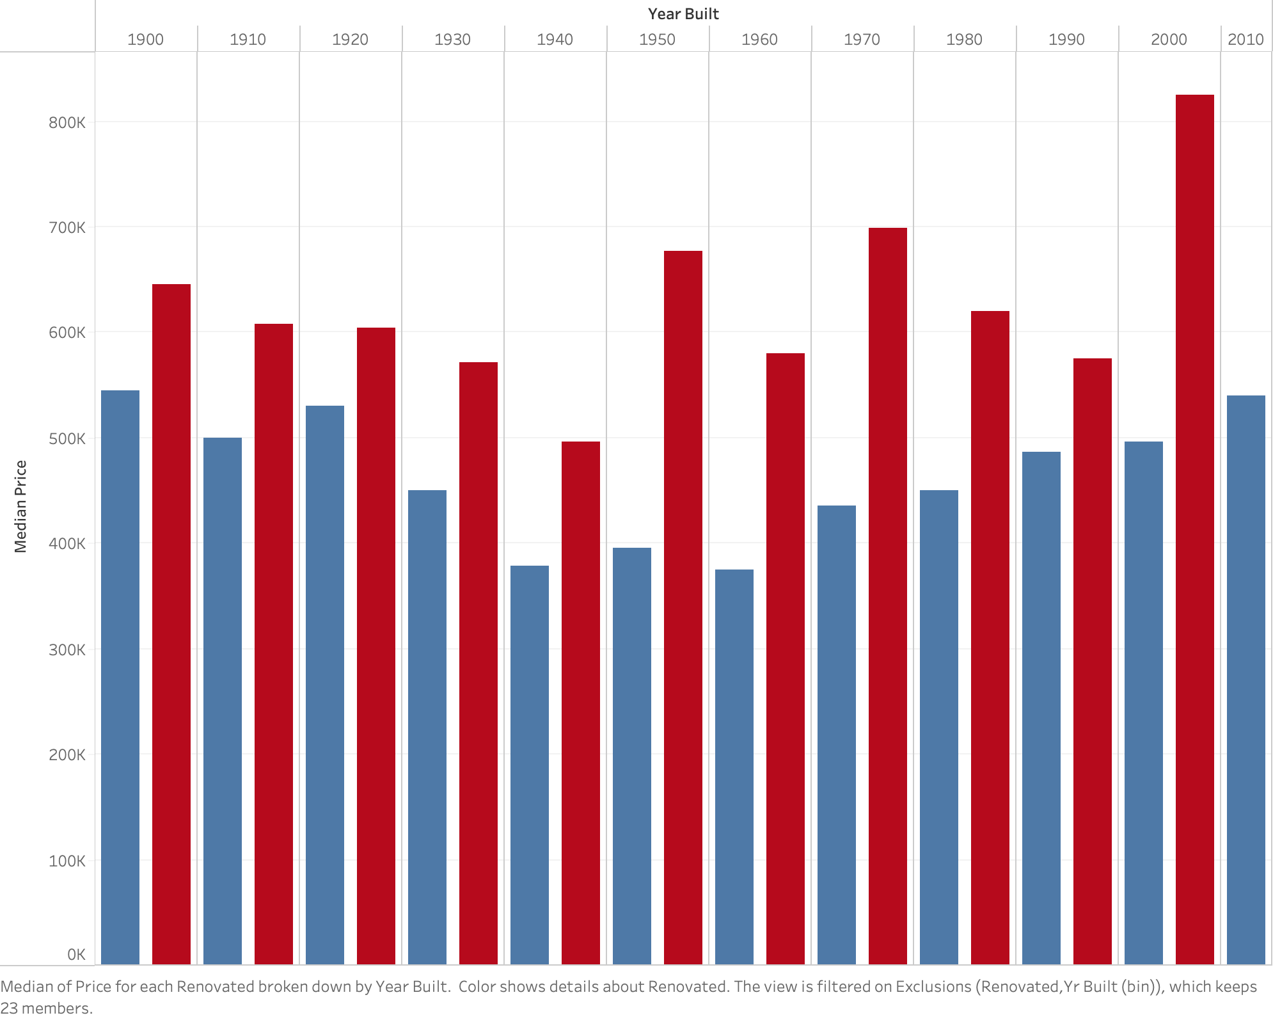
Year Built VS Median Price

Slide 21
Regression Method | N of Predictors | Transf.? | Train Set |  | Test Set
 |  |  | RMSE ($) | Adjusted R2 | RMSE ($) | Adjusted R2
Linear (Baseline) | 18 | No | 204,389 | 0.70 | 187,189 | 0.71
Linear | 11 | No | 205,435 | 0.69 | 187,945 | 0.71
Linear Transformed | 12 | Yes | 168,042 | 0.80 | 155,021 | 0.80
Ridge Regression (α = 1) | 12 | Yes | 168,056 | 0.80 | 154,984 | 0.80
Lasso Regression (α = 0.1) | 12 | Yes | 255,210 | 0.53 | 233,032 | 0.55
Polynomial (n=2) | 12 | Yes | 131,009 | 0.88 | 128,919 | 0.86
Extreme Gradient Boosting (Final) | 12 | Yes | 93,118 | 0.94 | 108,315 | 0.90

